Slide 1
ArrRss
An RSS Reader for the Pirate in Everyone

Slide 2

What is RSS?
RSS originally stood for Rich Site Summary, but is now is often called Really Simple Syndication.
RSS feeds constantly update you on the news from the website the feed is from.
Acts like a breaking news ticker at the bottom of a news channel.
Many websites will have an RSS feed. Some have multiple feeds for different sections of the site.
To find the RSS feed for a site, find the button with the RSS logo.

Slide 3
How to use an RSS feed
To use an RSS feed, you need an RSS feed reader. That is what ArrRss is.
A RSS reader takes the feeds and makes it easy to view them.
By clicking on the name of the feed you want to view, it gets a list of all of the updated stories from that feed.
ArrRss also lets you sort the feeds by category, so if you find something that you are interested in, it is easy to find related articles

Slide 4
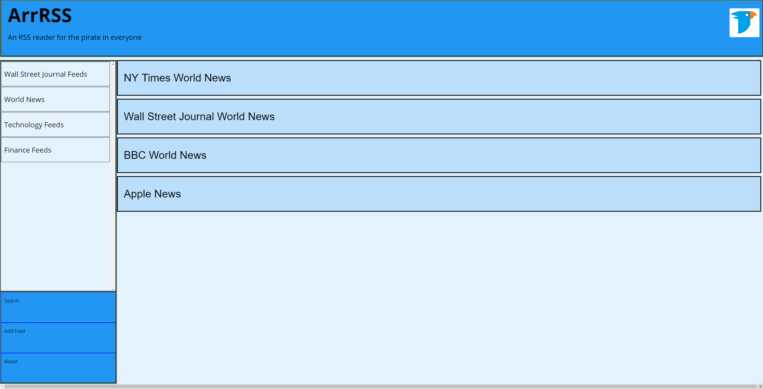
The Main Page
Notes:
Replace pic with new color scheme!!

Slide 5
Sites included in ArrRss
ArrRss has a lot of different RSS feeds to view
Economics
Bloomberg
Wall Street Journal Market News
The Economist
Science
Science Daily
BBC Science/Nature
Major news
Google News
BBC World News
Wall Street Journal U.S. Business

Slide 6
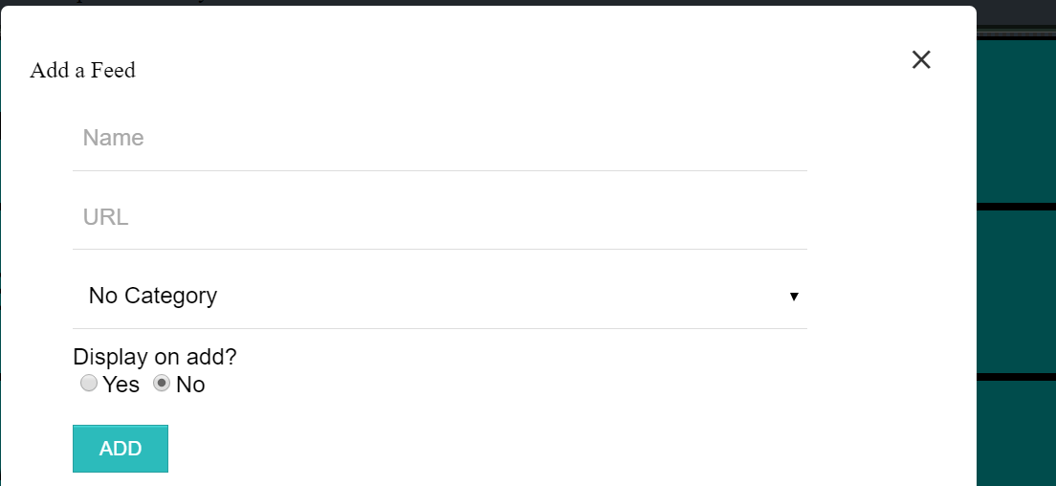
Or even add your own feeds!

Slide 7
HTML
A majority of the HTML for the page is made up of <div> tags.
The word div appears 101 times in the HTML file
Instead of linking to separate HTML files for each thing, we used the class attribute
This allowed a static sidebar and header
RSS feeds can be generated dynamically via the Add Feed button or statically
Doing this let us have defaults and user-added feeds

Slide 8
CSS
We structured our page to be a series of containers, the main one being dynamically sized (i.e width: calc(85% - 6px); )
Used the blue material design color scheme
#E3F2FD, #2196F3, #BBDEFB
Used overflow:scroll to make specific parts of page scrollable

Slide 9
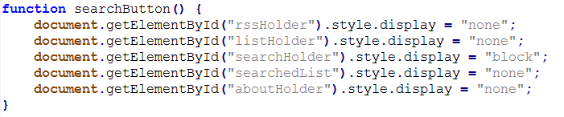
JavaScript: Content Viewing
Used JavaScipt to switch the main content pane depending on click
This system switches the current view easily

Slide 10
JavaScript: Adding New Feeds
When the Add button on the form is clicked, a new feed is created
The feed is added to an array of URLs, Tags, and Names.
The URL is parsed and formatted for the YQL Query
Finally a new div is created and a formatted feed is added correctly using var searchedFeed = document.createElement('div');

Slide 11
YQL
Short for Yahoo Query Language
Acts like SQL and handles data for: extracting HTML, converting XML/JSON, handling RSS, etc.
Syntax:
select * from rss where url=”select * from rss where url="http://www.wsj.com/xml/rss/3_7031.xml"”
Output in JSON or XML
YQL call for the New York Times:
https://query.yahooapis.com/v1/public/yql?q=select%20*%20from%20rss%20where%20url%3D%22http%3A%2F%2Frss.nytimes.com%2Fservices%2Fxml%2Frss%2Fnyt%2FWorld.xml%22&format=json&diagnostics=true&callback=printRSS

Slide 12
How the Feed is Accessed
The YQL query is hidden in the ID for the div containing the feed
When the feed is clicked, the ID is sent as a GET request which Yahoo handles and returns the feed data with a callback function
The callback funtion, printRSS, parses the data into a title, and link, which is added to the RSS display div

Slide 13
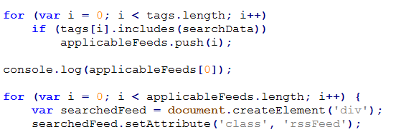
JavaScript: Searching
Maintain a list of ‘suitable’ feeds to respond with
Looks for tag matching based RSS data and the titles
Populates a formatted list of all valid feeds that are found

Slide 14
Demo!

